Slide 1




Group 05 - Digital art - EPS
Leon - Giulia - Julian - Paula - Rui - Anna
CONNECT
and share
1
Notes:
Rui

Slide 2

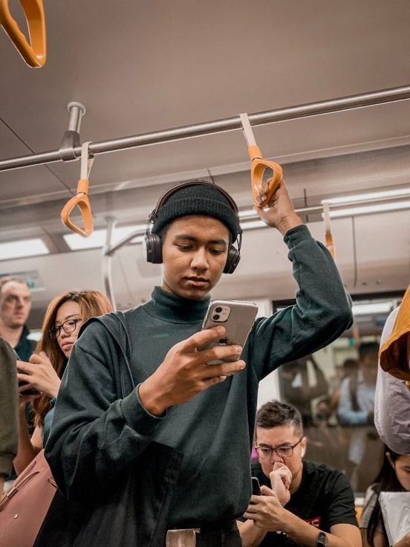

Problem Statement
Team
Connection
Target Group
Hardware
Software
Marketing
Communication
Problem
Statement
Digital Isolation
⟶ Metro passengers are physically packed but socially disconnected within private screen bubbles
Passive Users
⟶ Transit has shifted from a shared community space to a passive "digital void"
2
Notes:
Rui

Slide 3

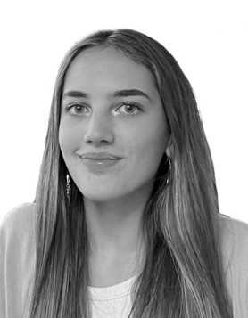
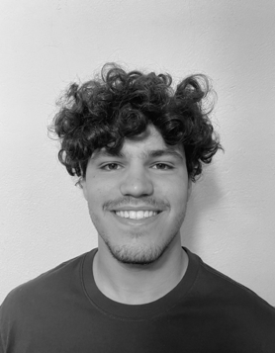
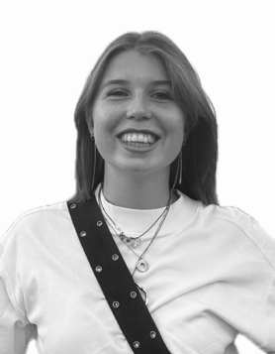
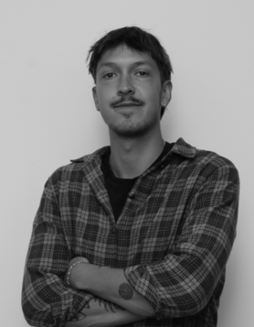

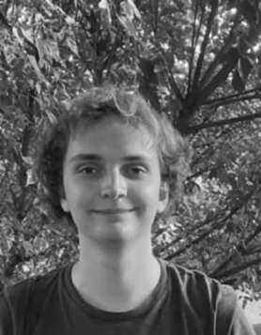
Problem Statement
Team
Connection
Target Group
Hardware
Software
Marketing
Communication
Paula Macías Olmedo
Industrial Organization Engineering
Rui Filipe Coutinho Mendes
Systems Engineering
Giulia Vaneeckhout
Product Development
Leon Gunsilius
Interactive Media
Anna Bentzen
Information Technology
Julian Bednarek
Computer Science
Our Team
3
Notes:
Rui

Slide 4
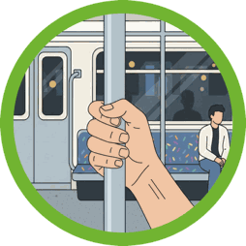

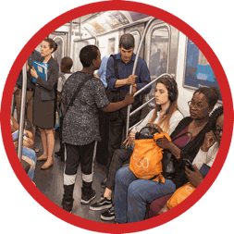
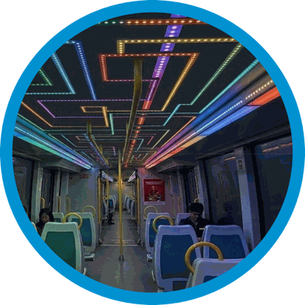

Problem Statement
Team
Connection
Target Group
Hardware
Software
Marketing
Communication
CONNECT
The metro is the city's veins CONNECT and share is here to bring it to life
Visual connection
  Interactive Poles
  Merging Colors
  Presence of each individual changes the collective whole
  Shared artwork
Solution
4
Notes:
Anna

Slide 5
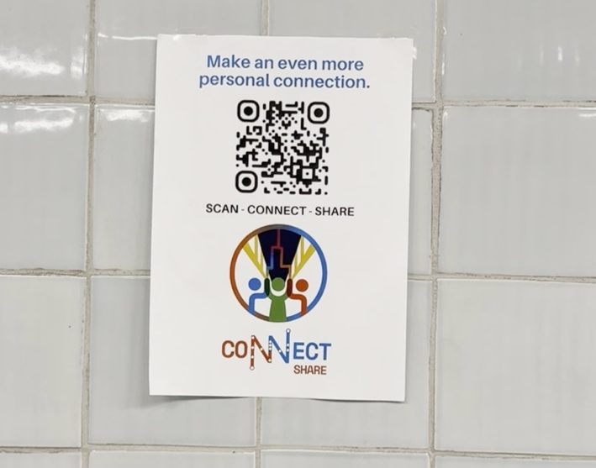
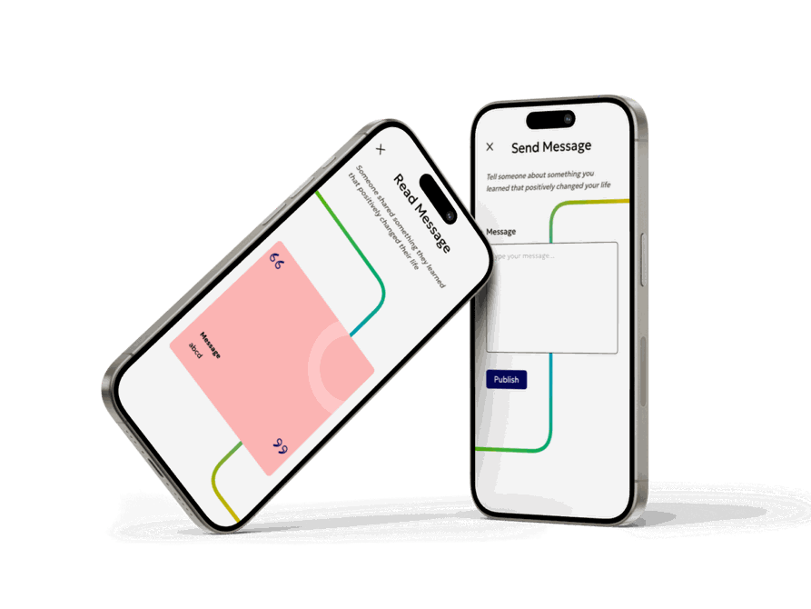
Problem Statement
Team
Connection
Target Group
Hardware
Software
Marketing
Communication
Personal connection
Send Message
  “Tell someone about something you learned that positively changed your life”
Read Message
  “Someone shared something they learned that positively changed their life”
5
Notes:
Leon

Slide 6


Problem Statement
Team
Connection
Target Group
Hardware
Software
Marketing
Communication
Young Urban Commuters (18-45)
  Profile: Students & young professionals.
  The problem: "Alone together" paradox
  Why CONNECT Fits: Tech-loving users who want mental well-being and real connections.
  Our goal: Stop passive scrolling with a fun, real-world moment
Target group
6
Notes:
Paula

Slide 7

Problem Statement
Team
Connection
Target Group
Hardware
Software
Marketing
Communication
Hardware development
Velostat:
  Detects presurre and its magnitude
  Copper plates are easy to recycle
CAN bus:
  Works well in noisy enviroment (must have inside the metro)
  Extremely reliable and scalable
PA Nanovia rail:
  Approved to use inside the metro
  Fire resistant
7
Notes:
Julian

Slide 8
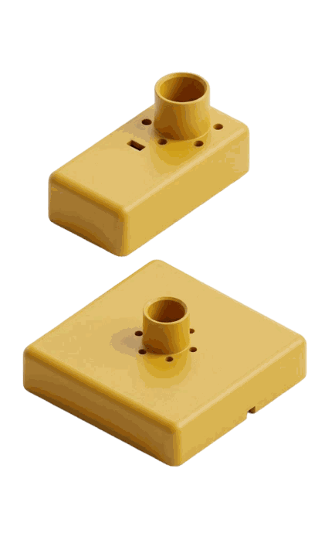
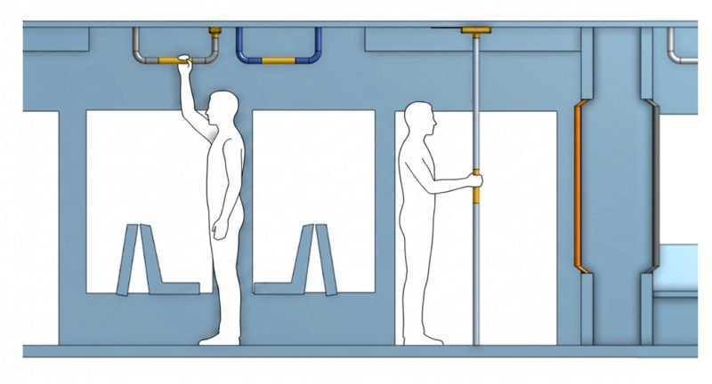
Problem Statement
Team
Connection
Target Group
Hardware
Software
Marketing
Communication
8
Notes:
Julian

Slide 9
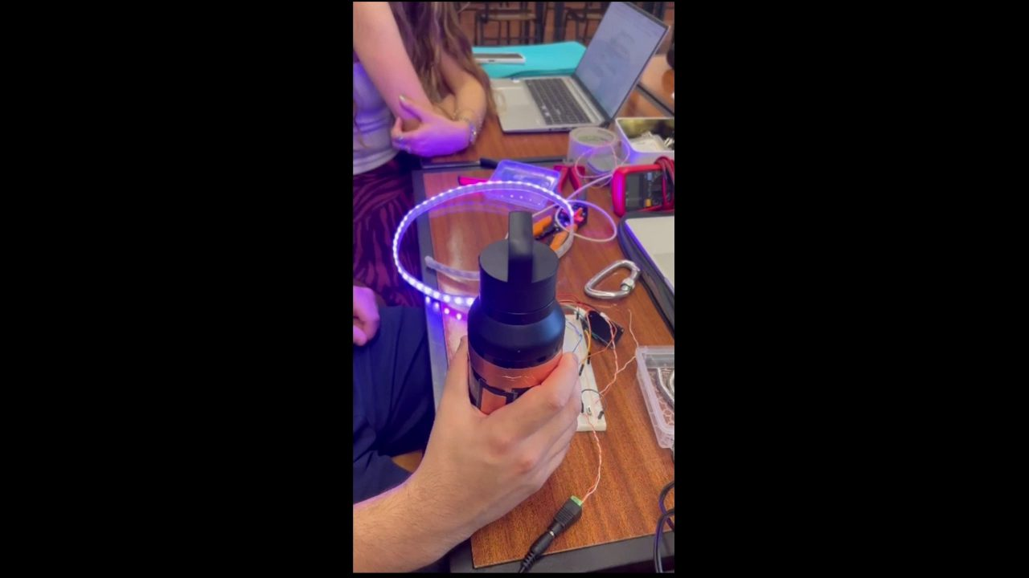
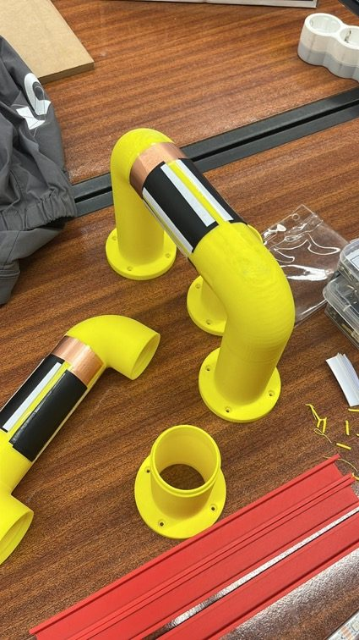
Problem Statement
Team
Connection
Target Group
Hardware
Software
Marketing
Communication
9
Notes:
Julian

Slide 10
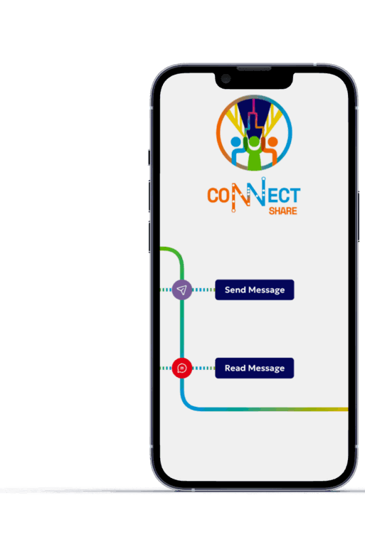
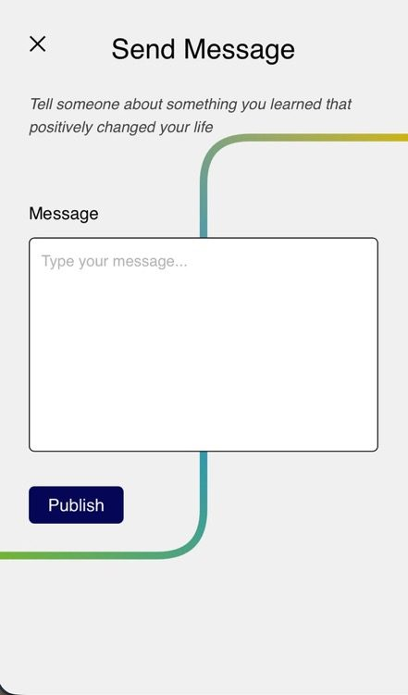
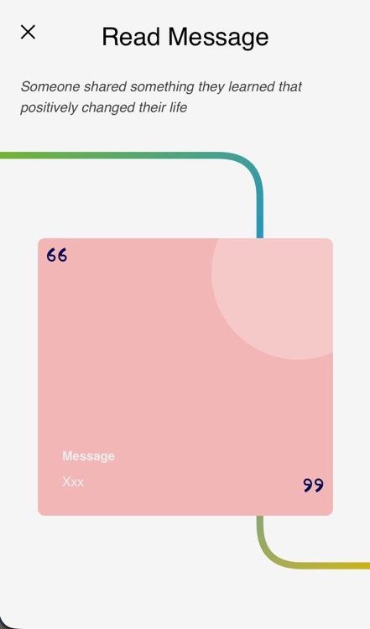
Problem Statement
Team
Connection
Target Group
Hardware
Software
Marketing
Communication
Software development
Stack
Next.js, Supabase, deployed on Vercel.
10
Notes:
Anna

Slide 11
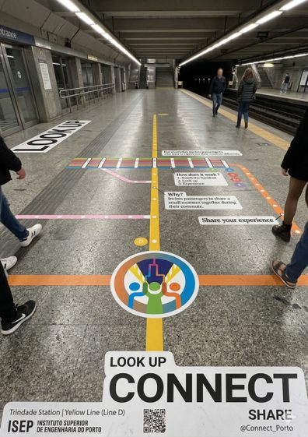
Problem Statement
Team
Connection
Target Group
Hardware
Software
Marketing
Communication
Marketing
Social Marketing
  Focus on social behavioural change
  Emotional value
Main competitor:
  The smartphone.
  Strategy: Utilise it by intentional delay
Action plan
  Guerrilla marketing in stations
  Digital storytelling via social media.
11
Notes:
Giulia

Slide 12
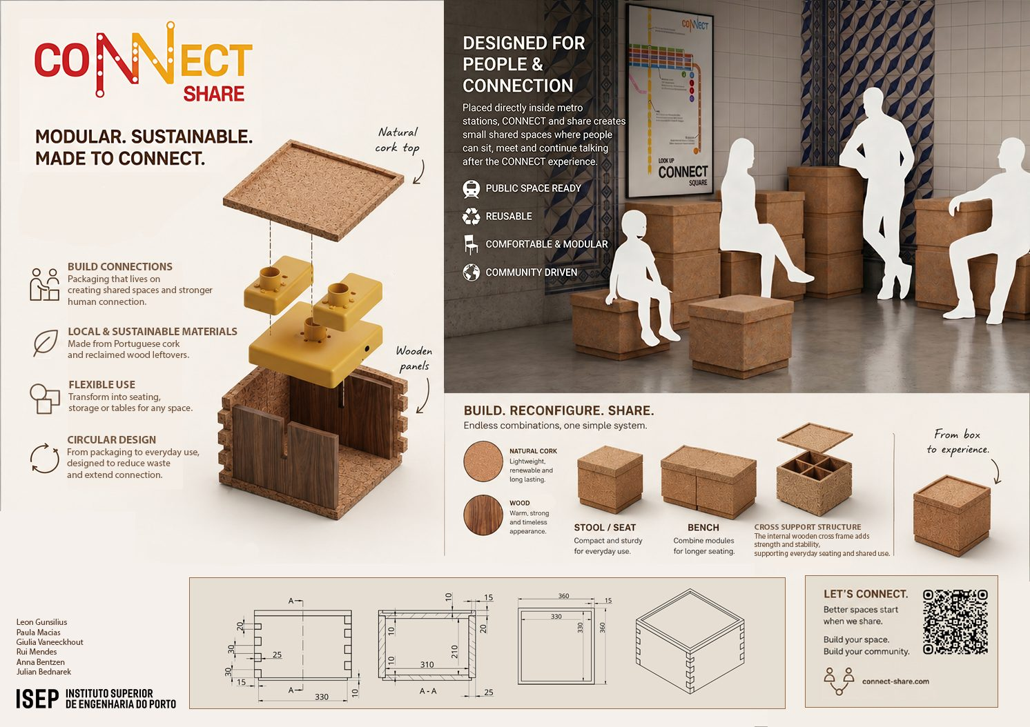
Problem Statement
Team
Connection
Target Group
Hardware
Software
Marketing
Communication
12
Notes:
Giulia

Slide 13
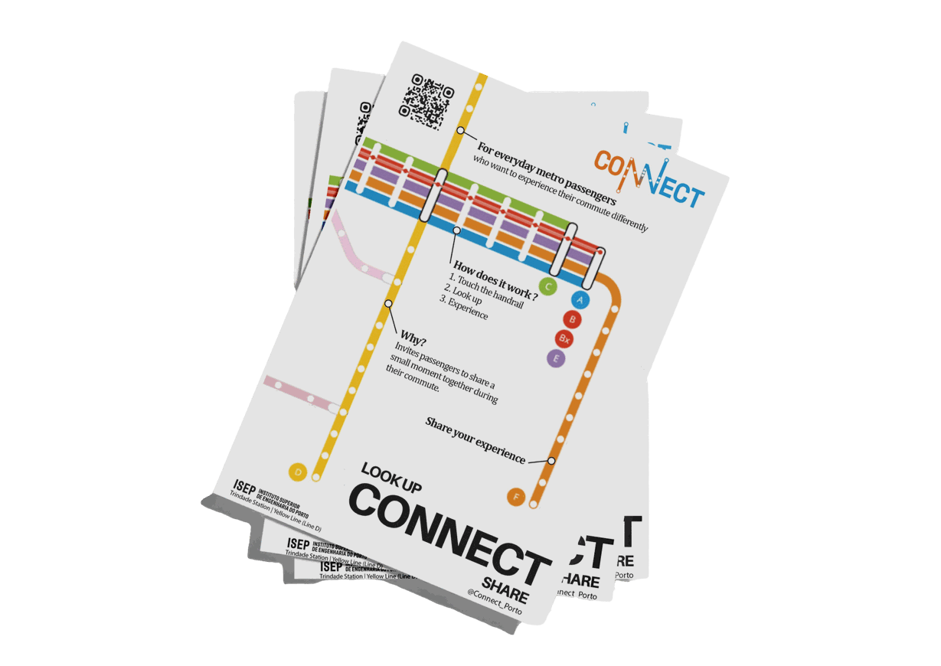

Problem Statement
Team
Connection
Target Group
Hardware
Software
Marketing
Communication
Communication
  Metro elements
  Color pallette
  Logo, name, and slogan
  Subway map
13
Notes:
Leon

Slide 14
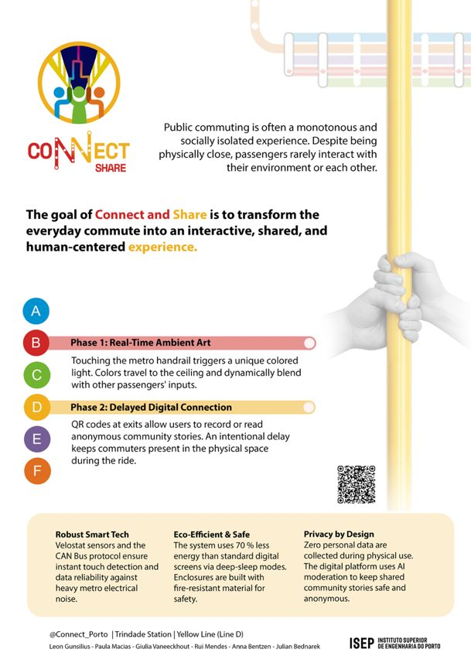
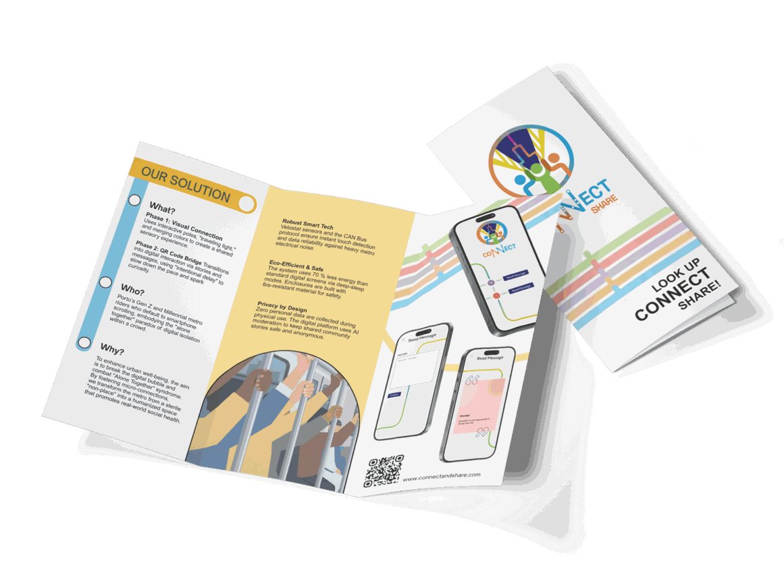
Problem Statement
Team
Connection
Target Group
Hardware
Software
Marketing
Communication
Communication
14
Notes:
Leon

Slide 15
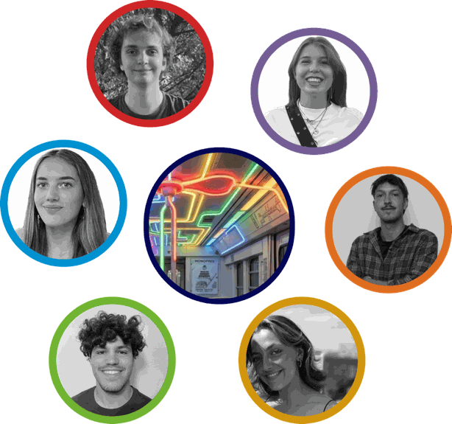
Problem solved
Successfully addressing digital isolation
Hardware
Achieves instant touch detection to activate interactive LED lights on the ceiling
Software
Processes and displays anonymous community messages while protecting user privacy
Result
Transforms a cold, routine commute into a human, shared experience
Conclusion
15
Notes:
Paula

Slide 16
Group 05 - Digital art - EPS
Leon - Giulia - Julian - Paula - Rui - Anna
THANK
YOU
16
Notes:
Rui

